Slide 1

Alex Vrhel Diana Wang Camille Birch Michael Wang

Slide 2
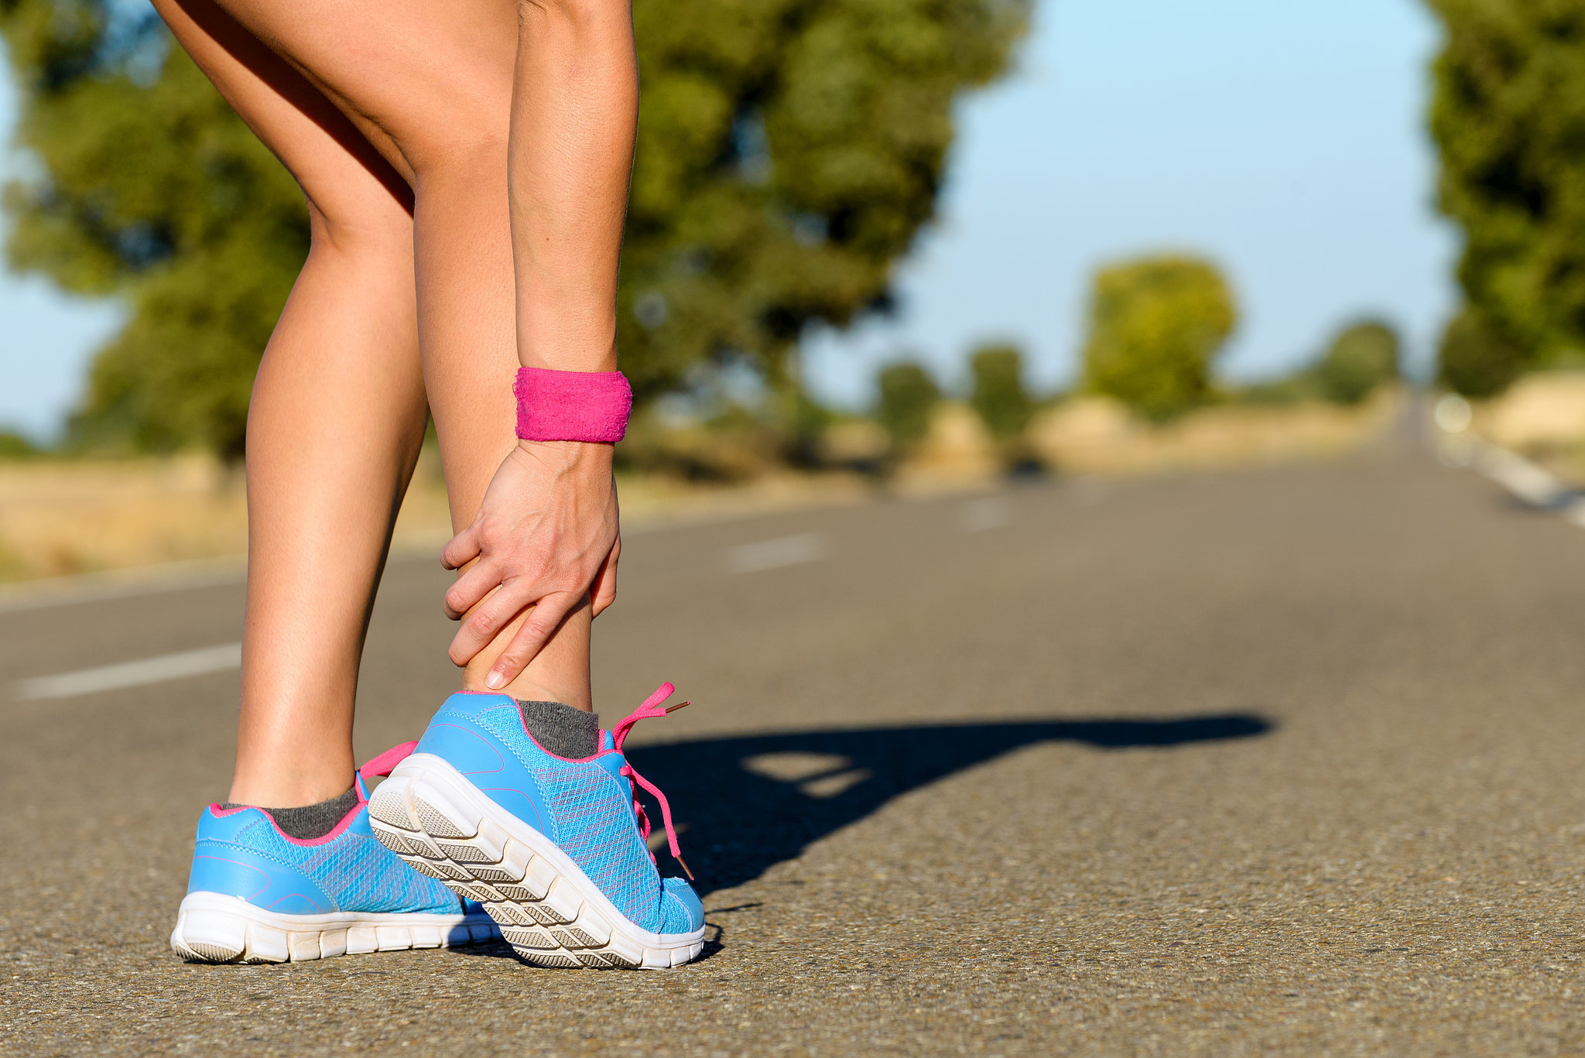
The Problem
Runners often deal with repetitive stress injuries
Reluctant to admit when injured
Want to understand the causes and handle it independently

Slide 3
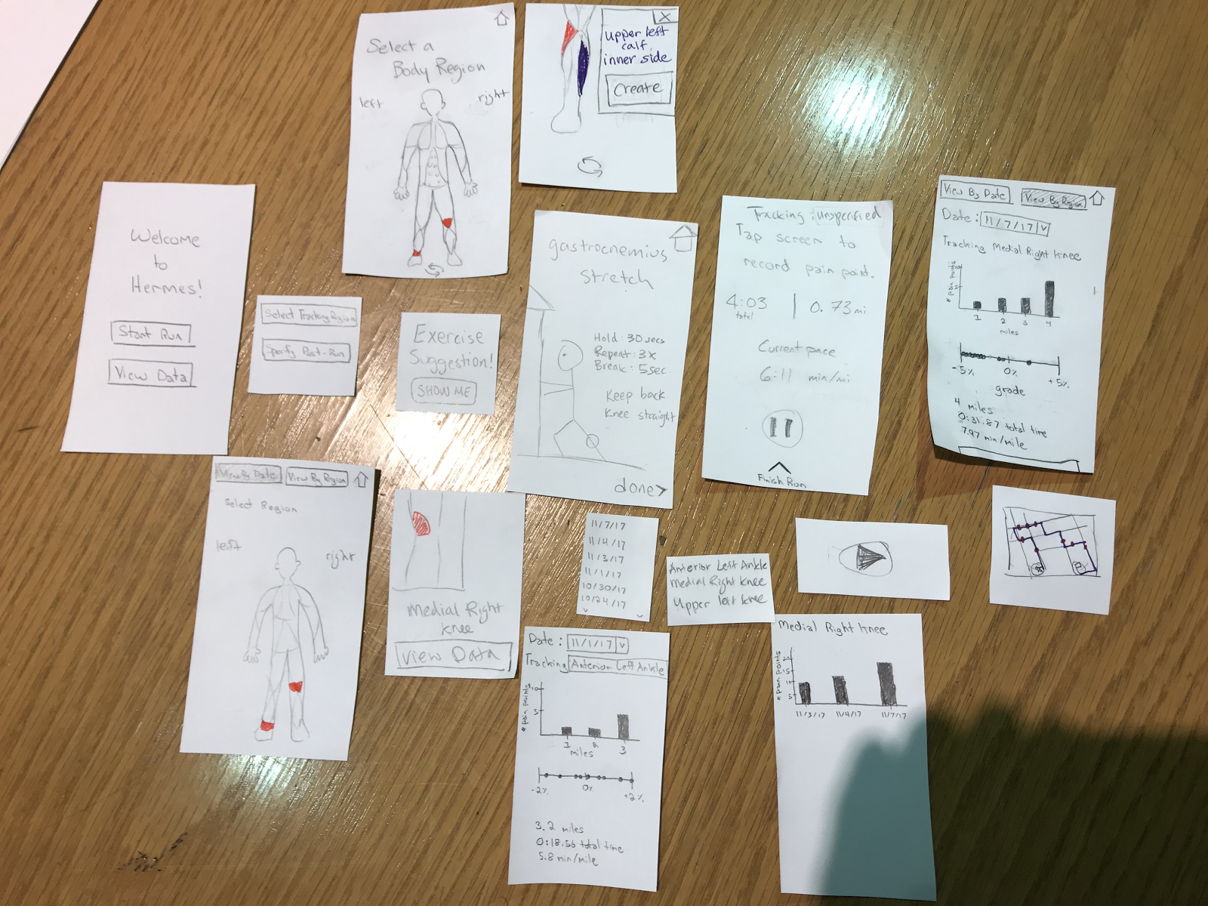
Initial Paper Prototype

Slide 4

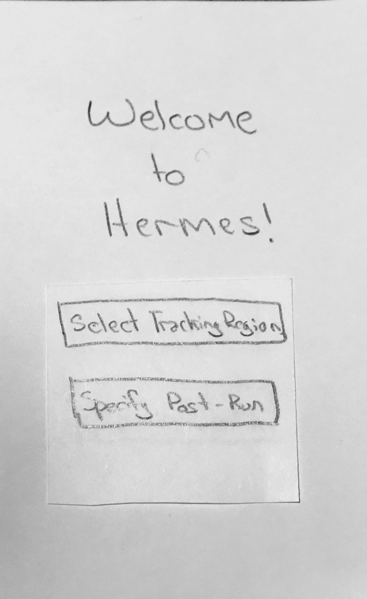
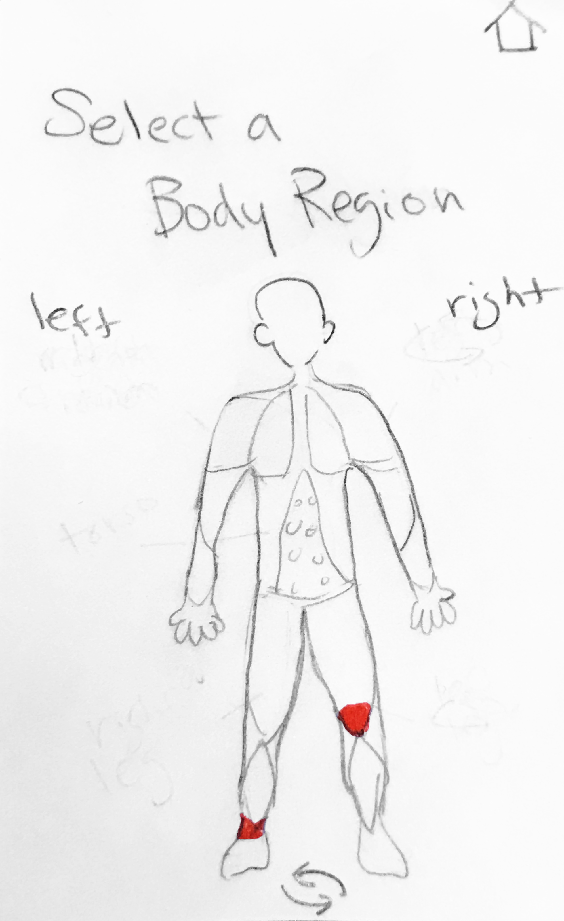
Track a workout and related pain
Task 1

Slide 5
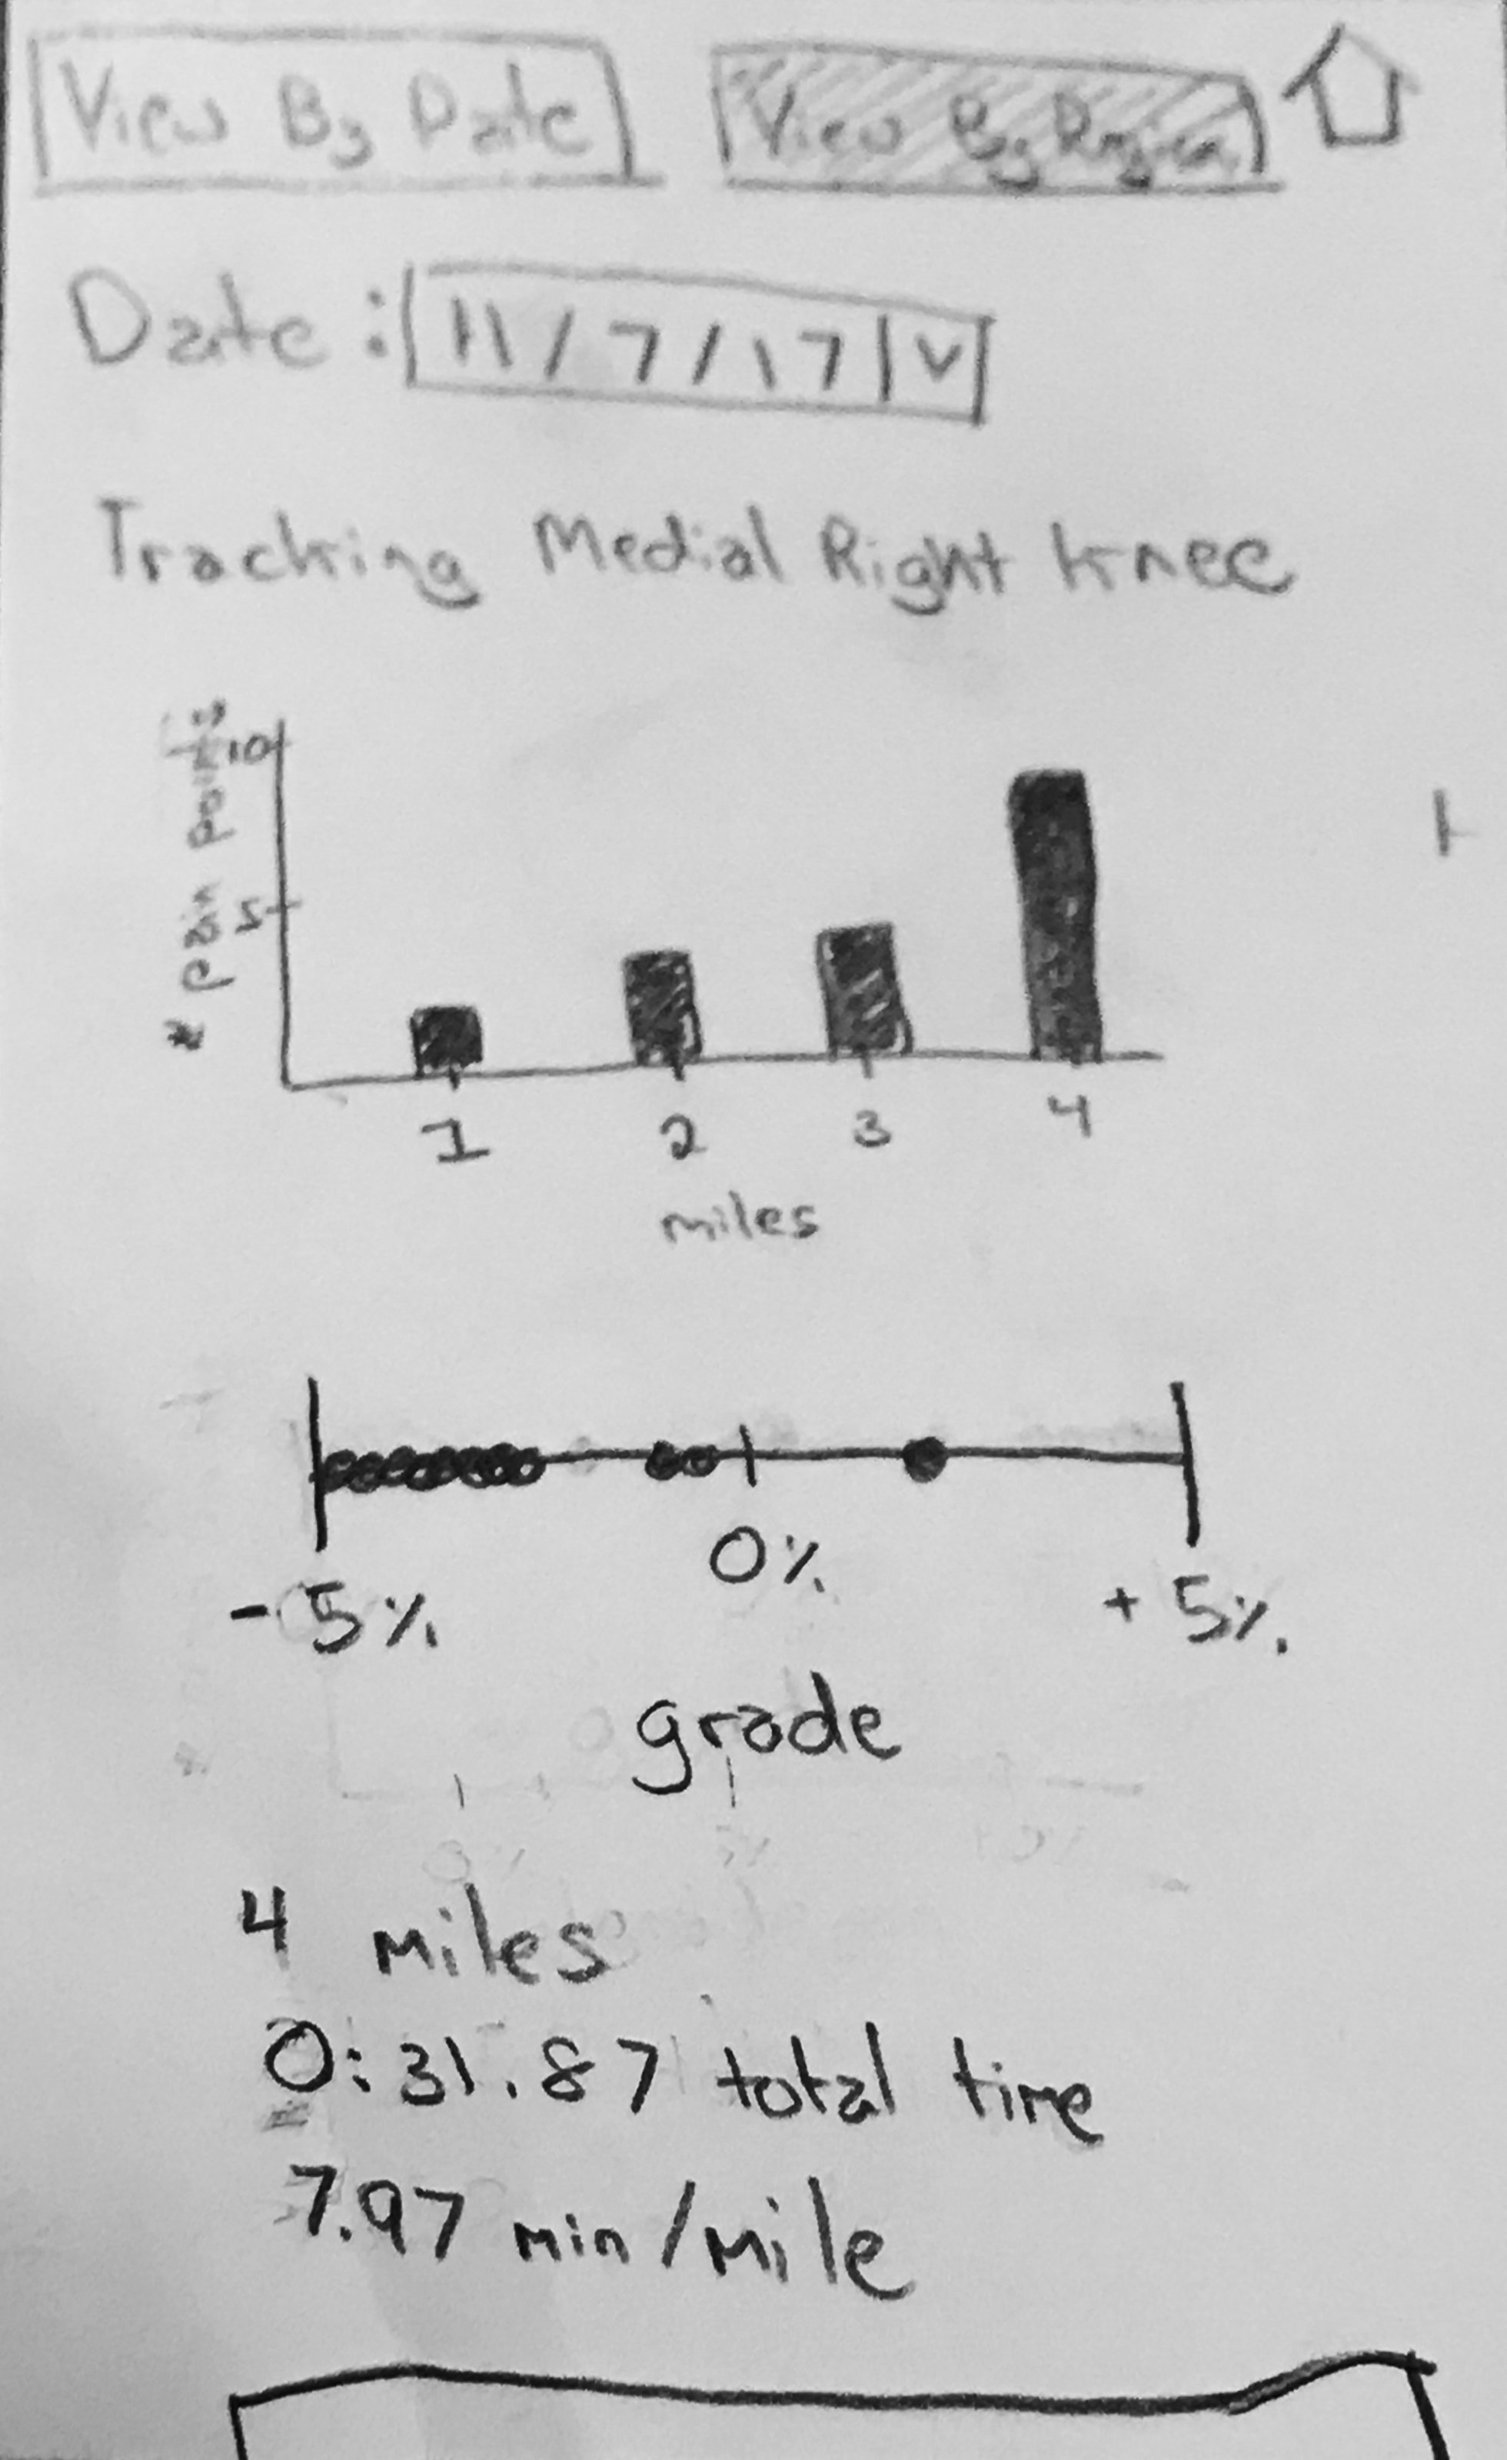
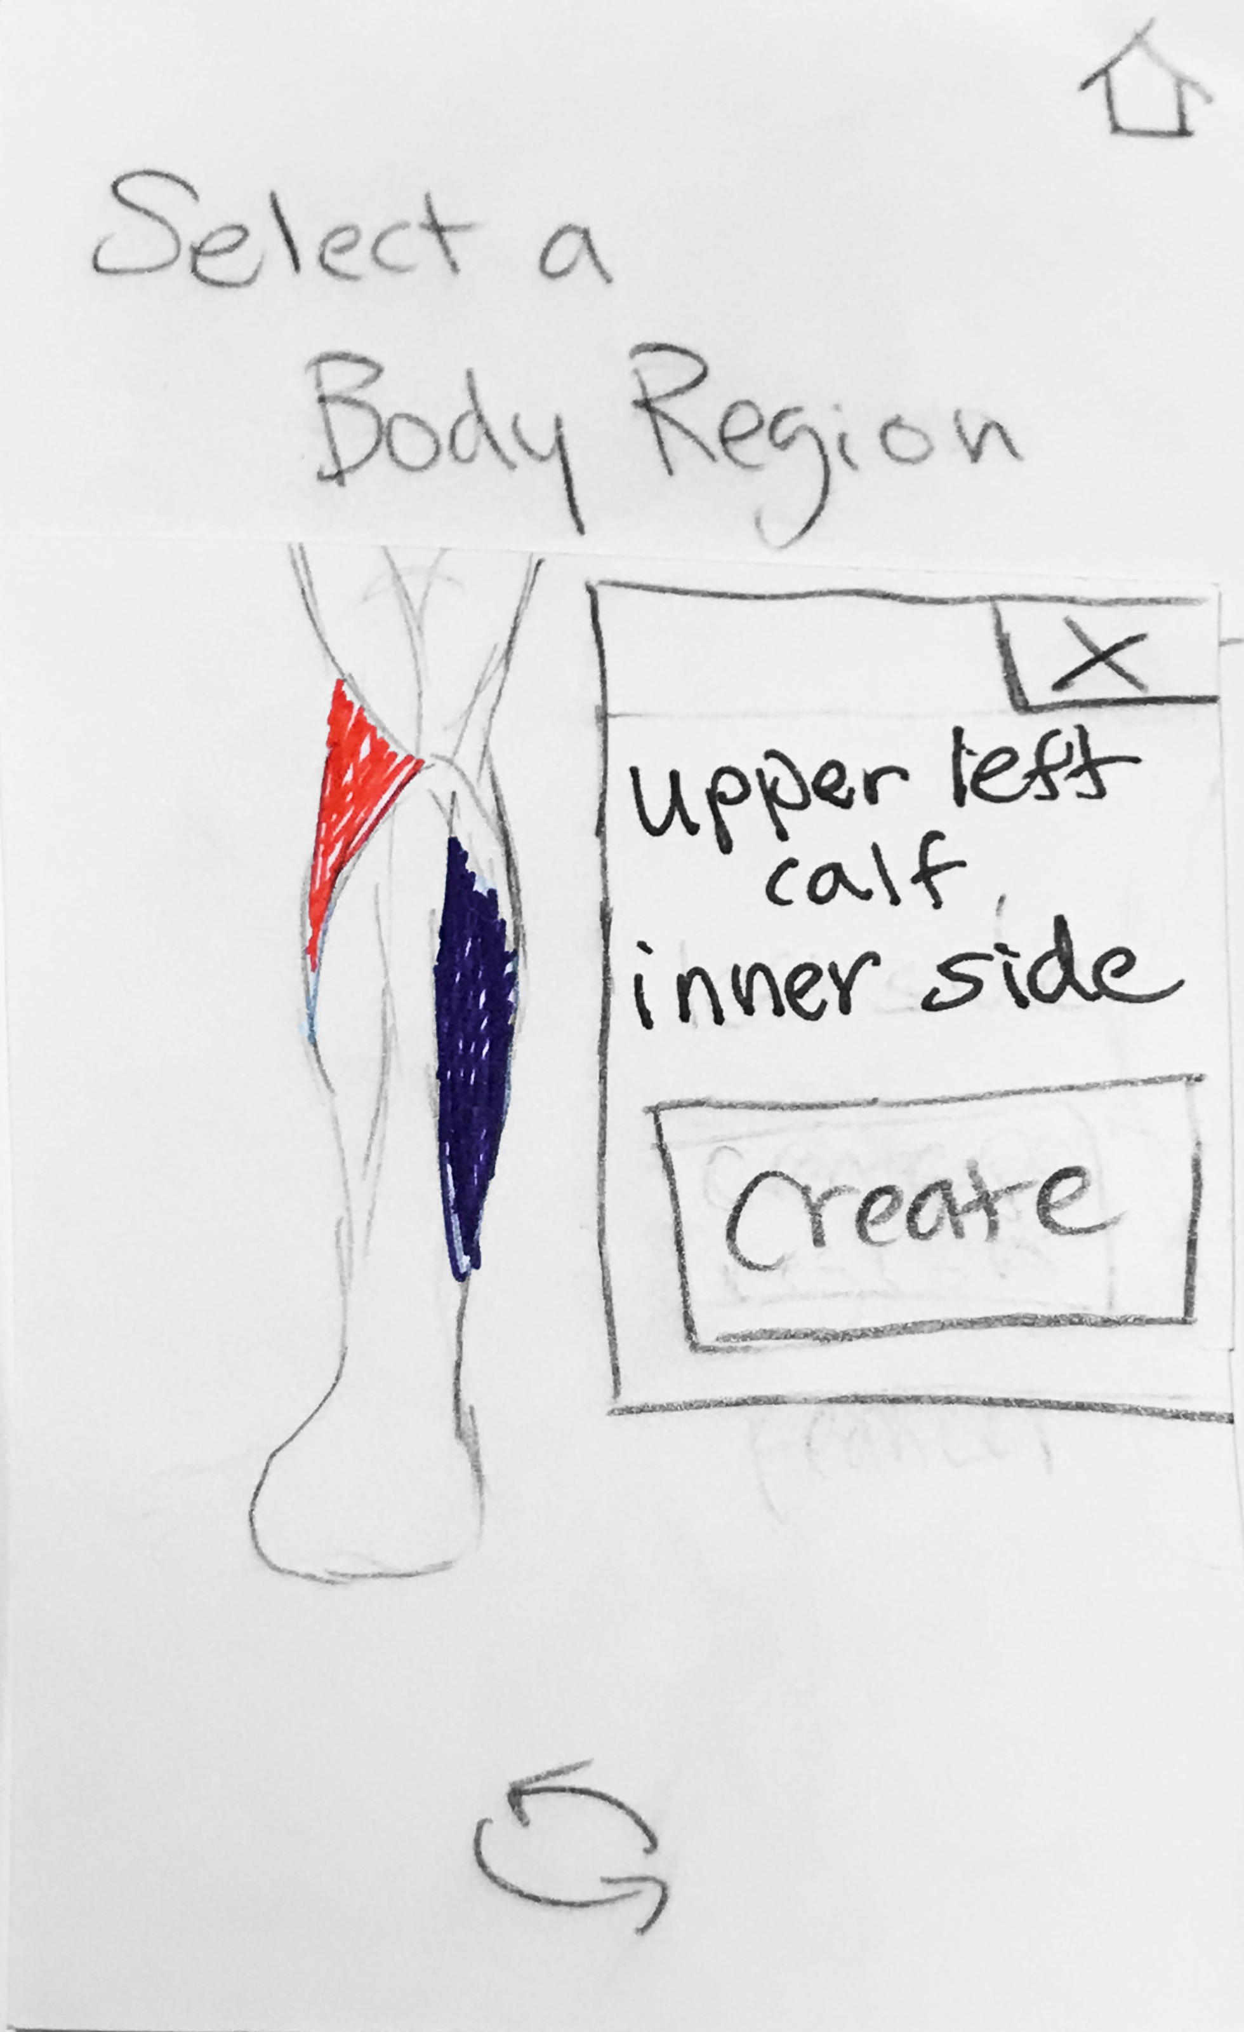
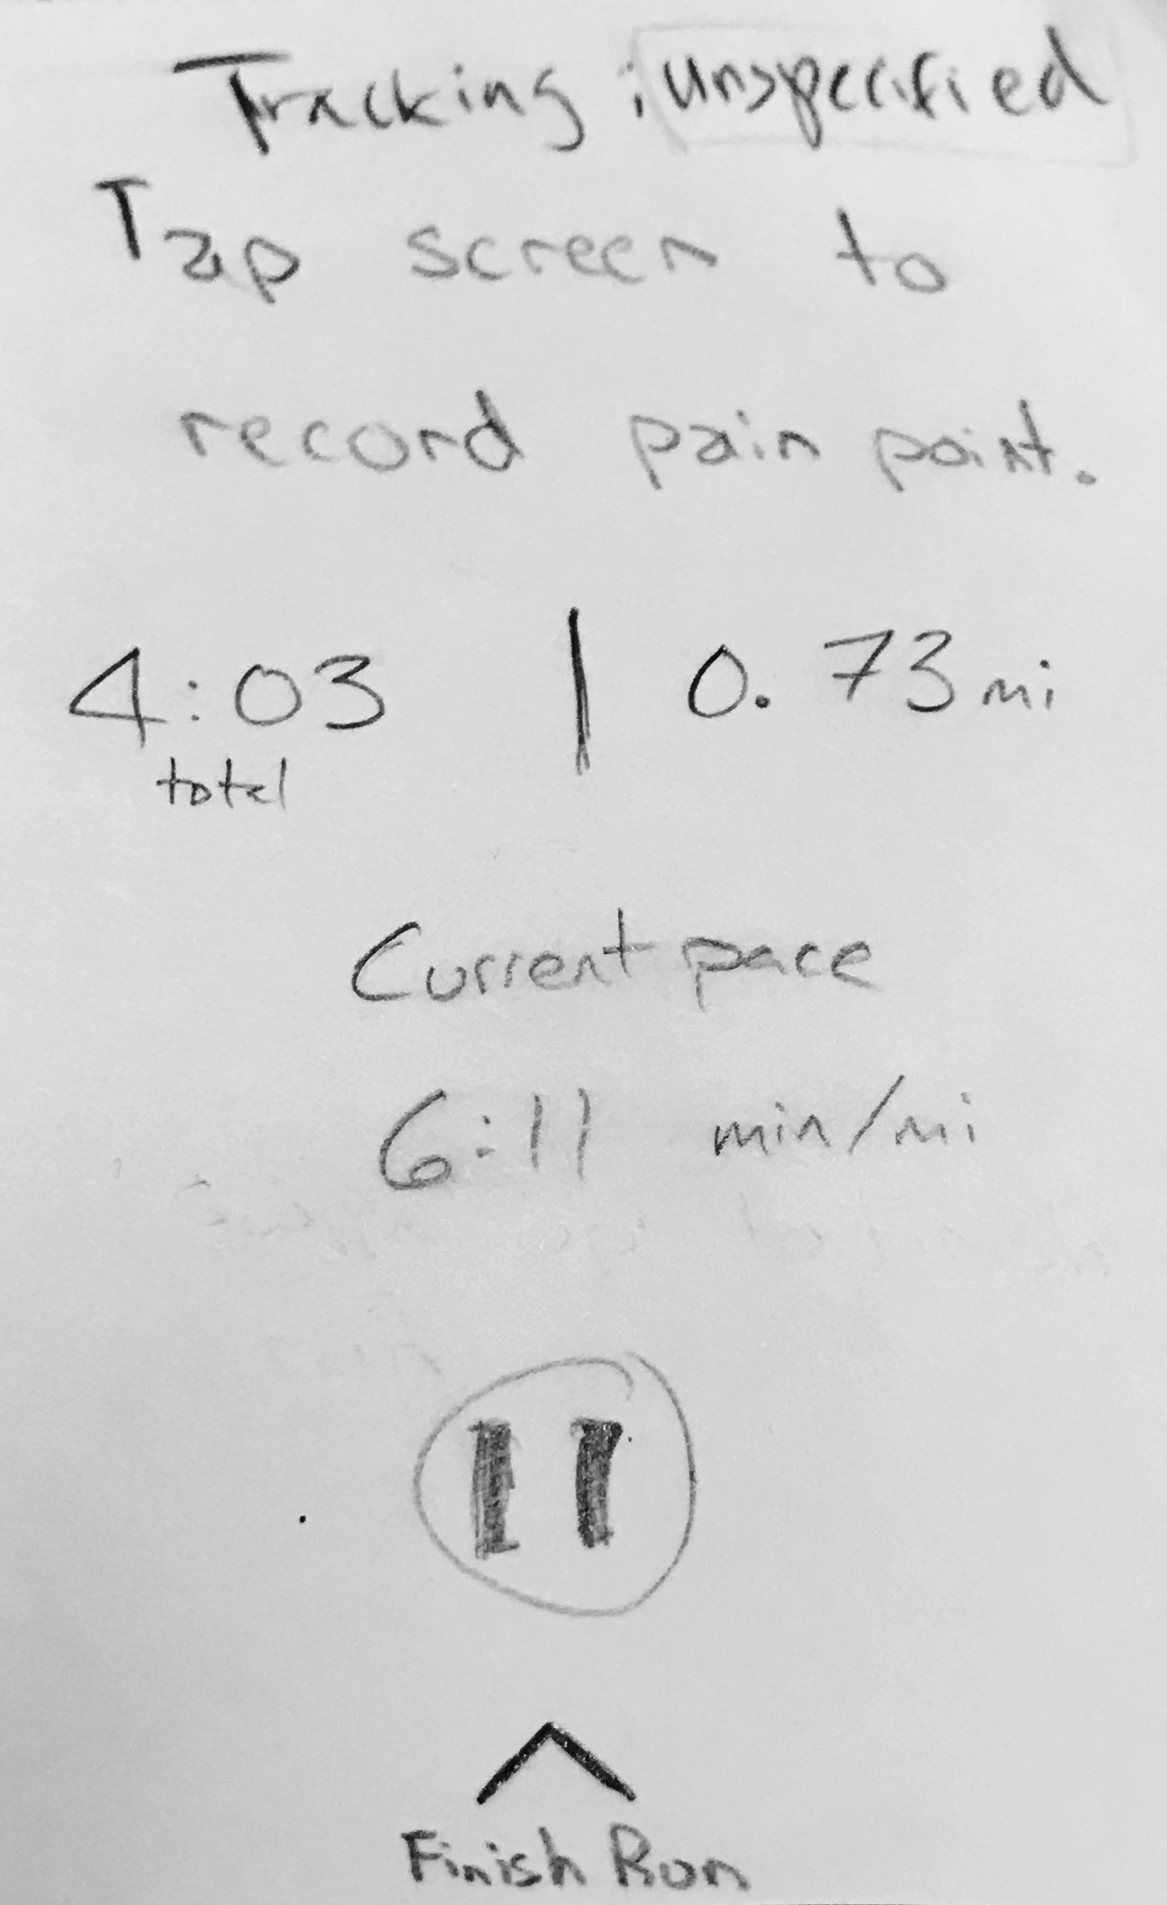
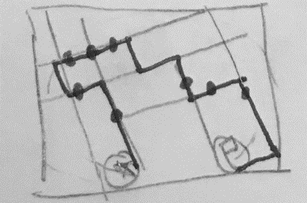
Track a workout and related pain
Task 1

Slide 6
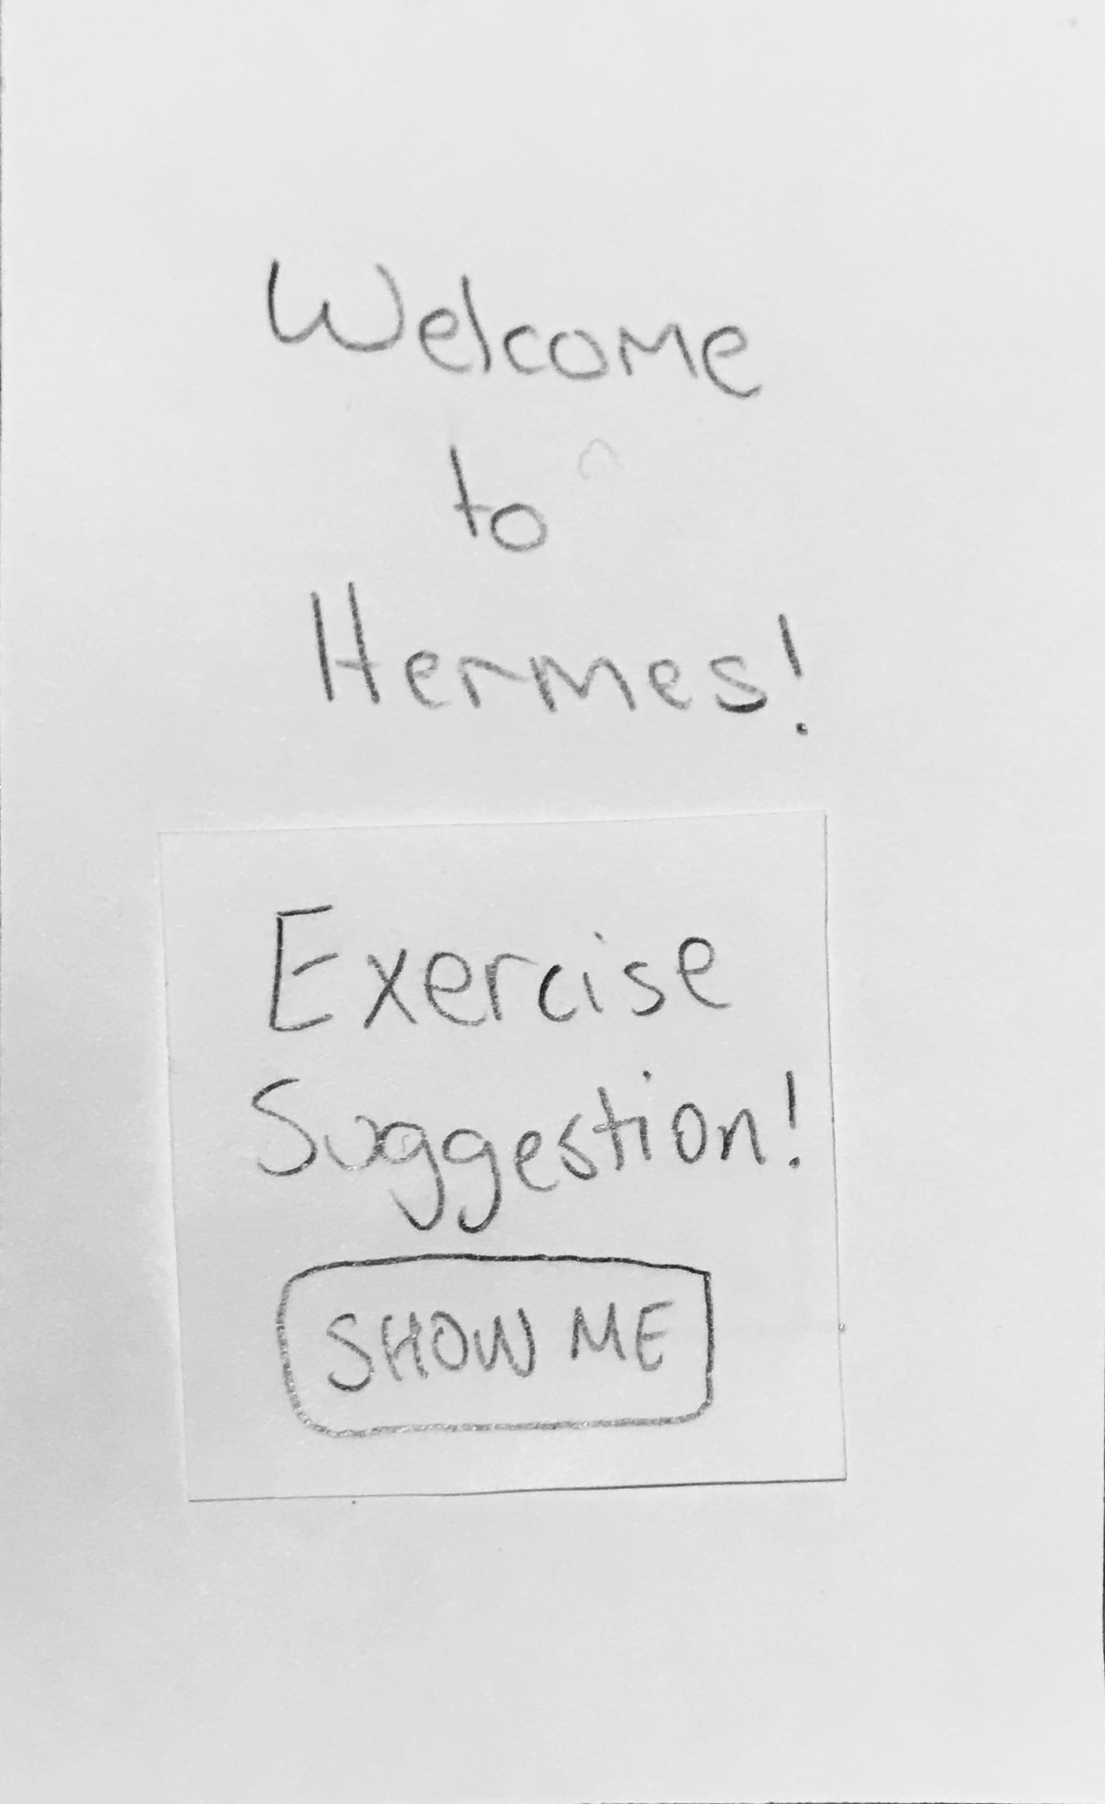
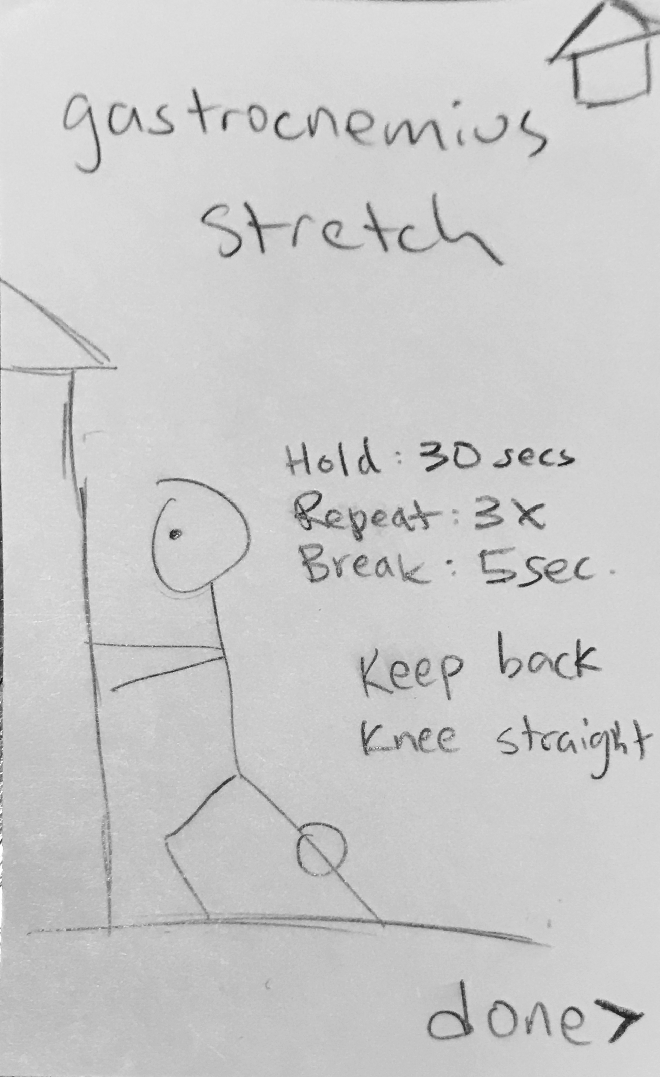
Receive injury prevention suggestions
Task 2

Slide 7
Testing Process
Perform both primary tasks
Reflect on data from past run
Discuss method of input
Discuss tracking multiple body parts
3 UW students

Slide 8
Testing Results
Critical Incidents
Unclear how to proceed through first task
Added instructions
Moved body part selection to post-run
Exercise suggestion
was disruptive
Moved to post-run
Added tips to pre-run
Missing data that
athletes wanted
Added pace
Added insights to summary page

Slide 9
Testing Results
Critical Incidents
Unclear how to proceed through first task
Added instructions
Moved body part selection to post-run
Exercise suggestion
was disruptive
Moved to post-run
Added tips to pre-run
Missing data that
athletes wanted
Added pace
Added insights to summary page

Slide 10
Testing Results
Critical Incidents
Unclear how to proceed through first task
Added instructions
Moved body part selection to post-run
Exercise suggestion
was disruptive
Moved to post-run
Added tips to pre-run
Missing data that
athletes wanted
Added pace
Added insights to summary page

Slide 11
Testing Results
Further Refinement
Only support one body part per run
Use wearable ring device for pain input

Slide 12
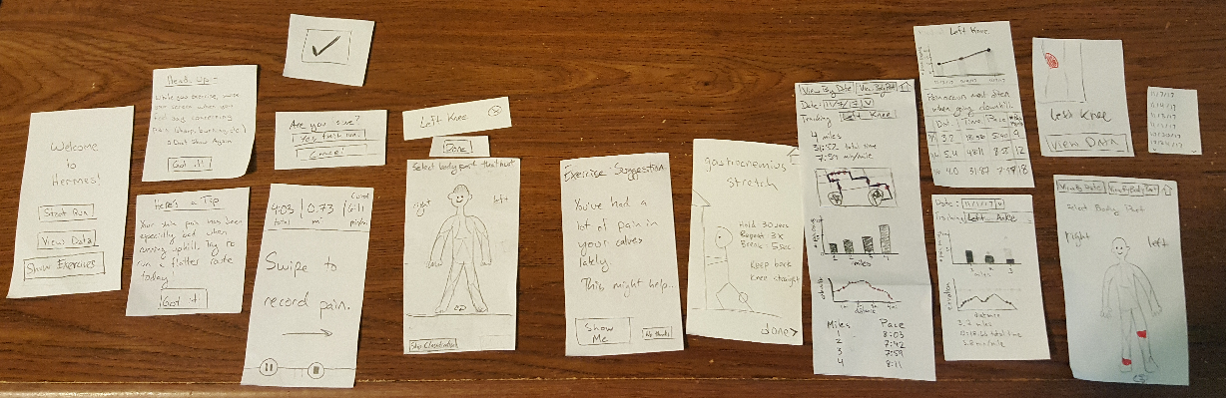
Final Paper Prototype

Slide 13
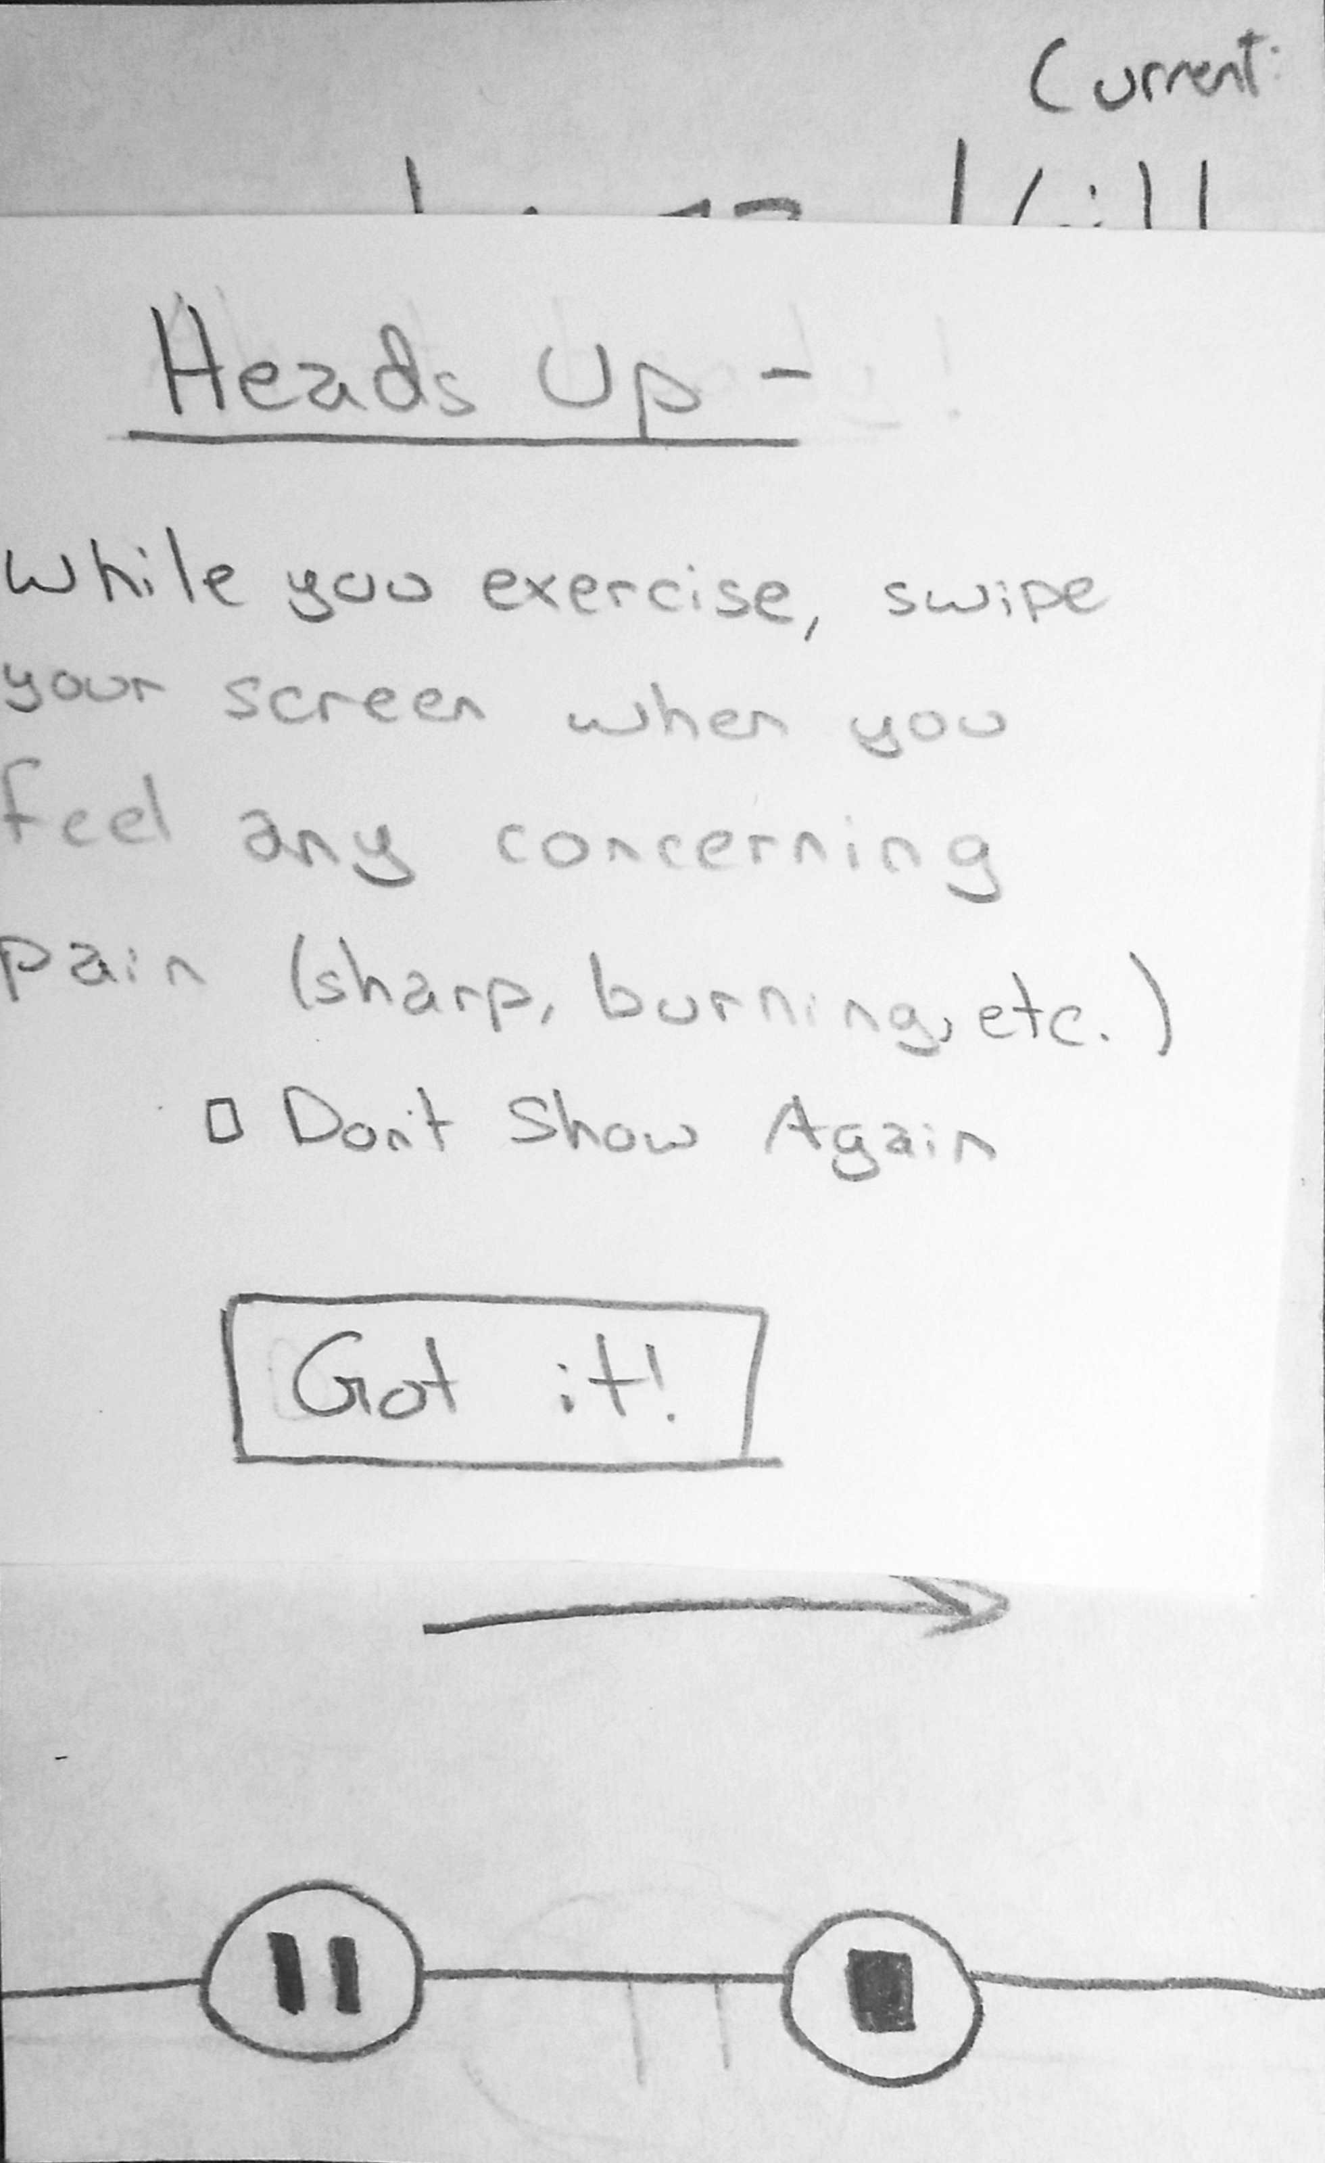
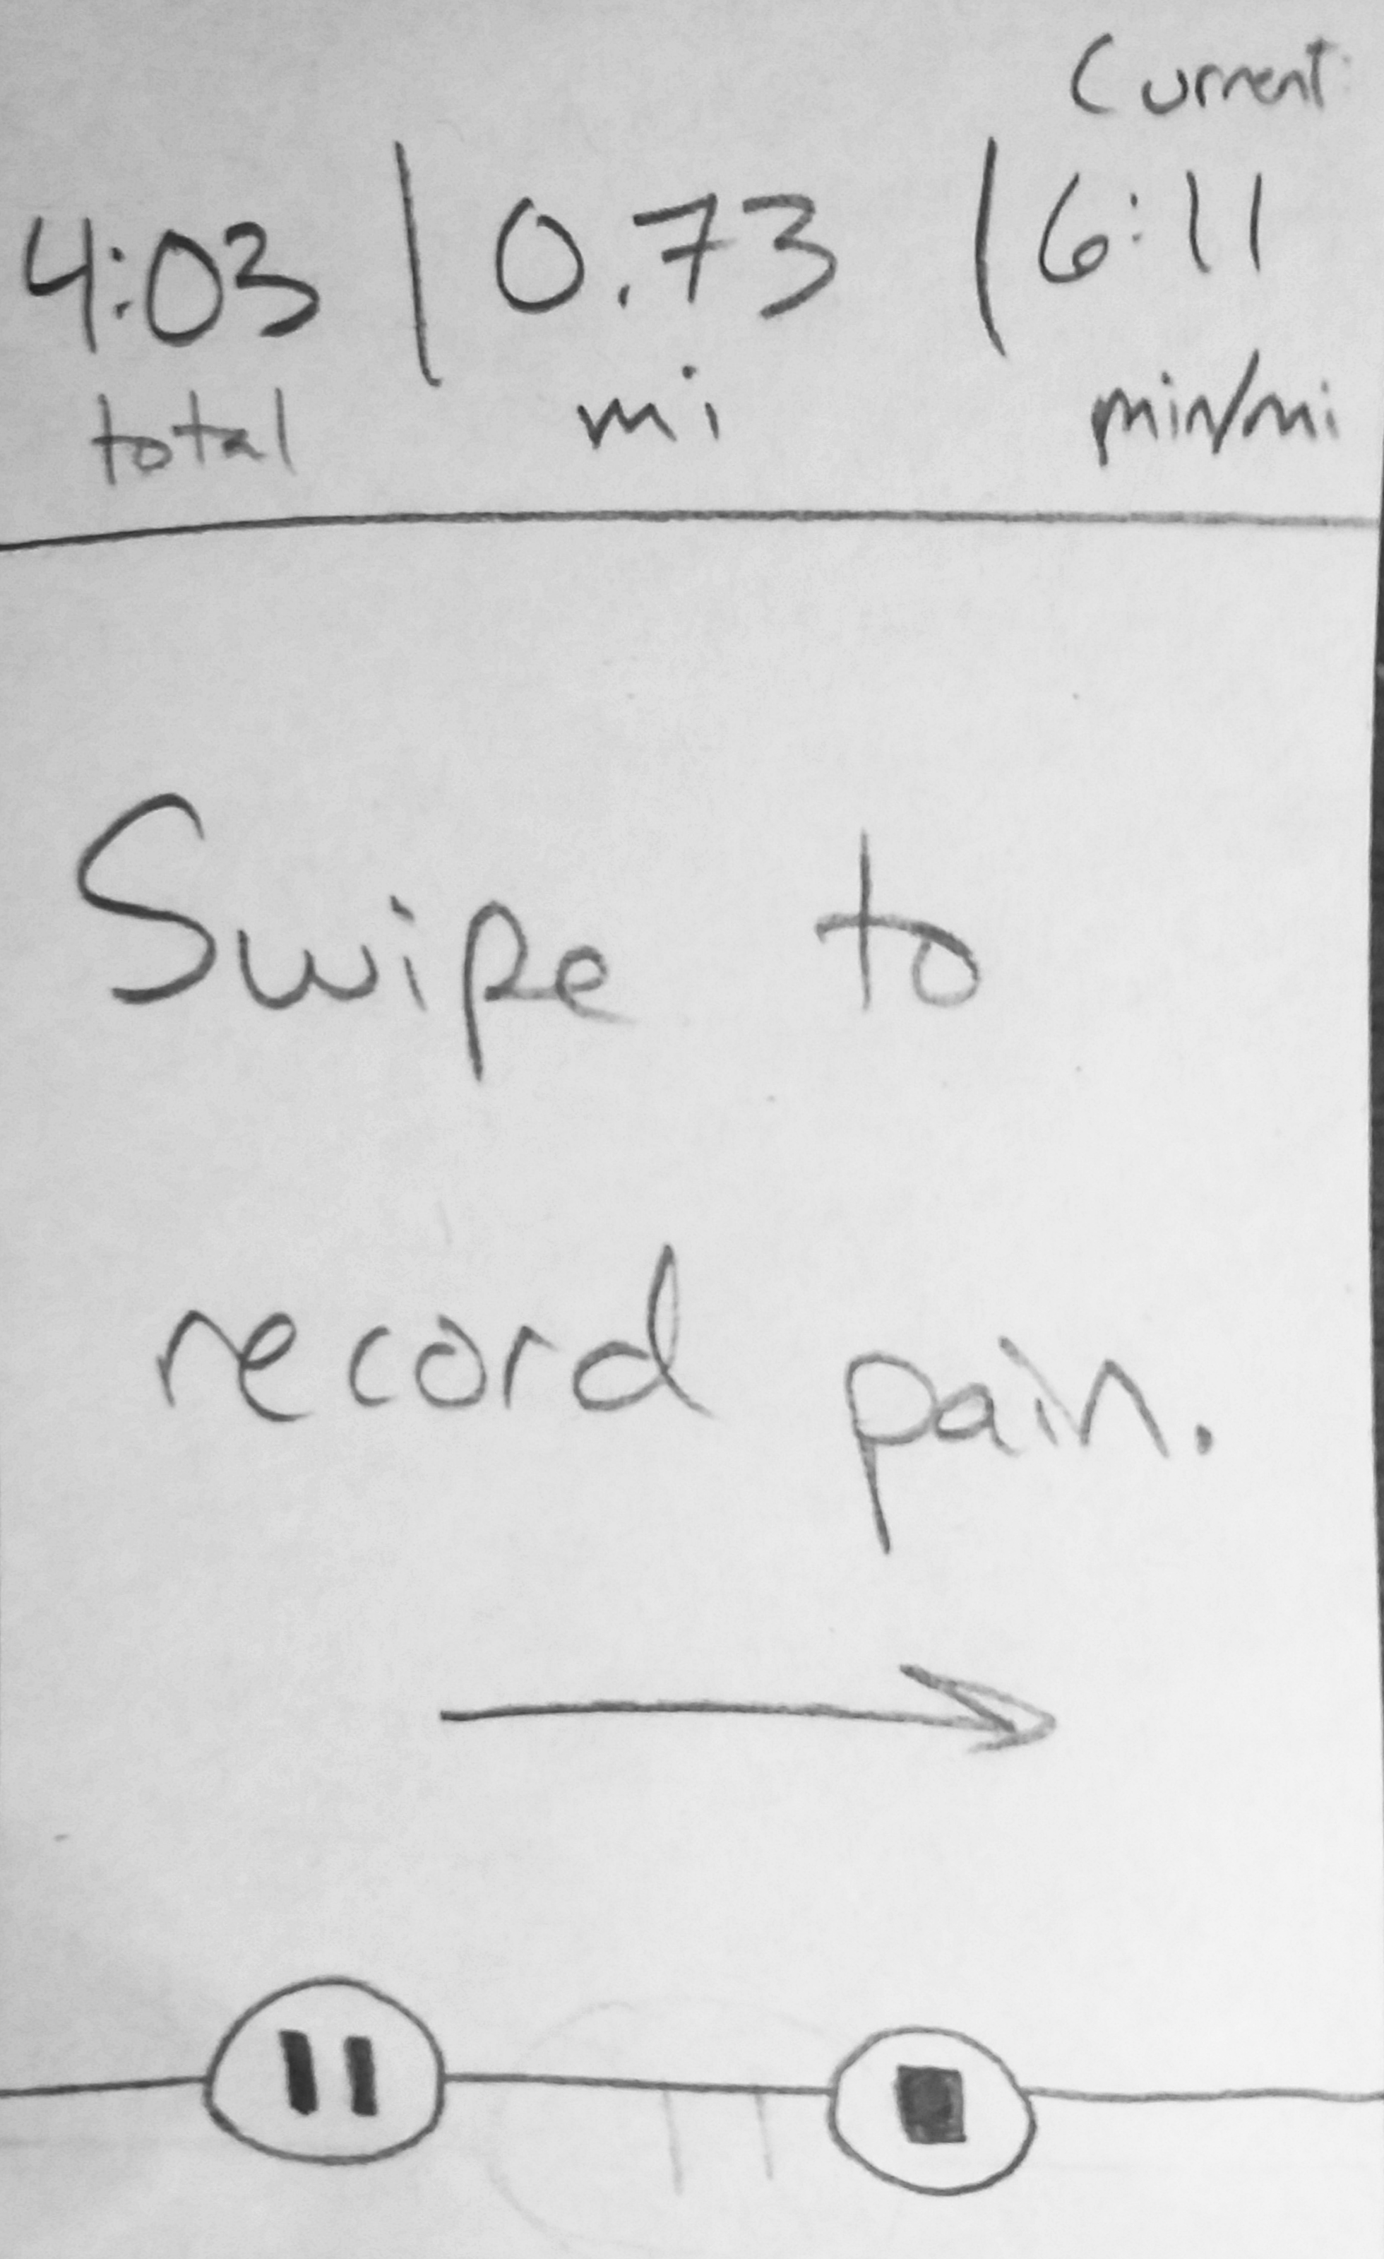
Track a workout and related pain
Task 1

Slide 14
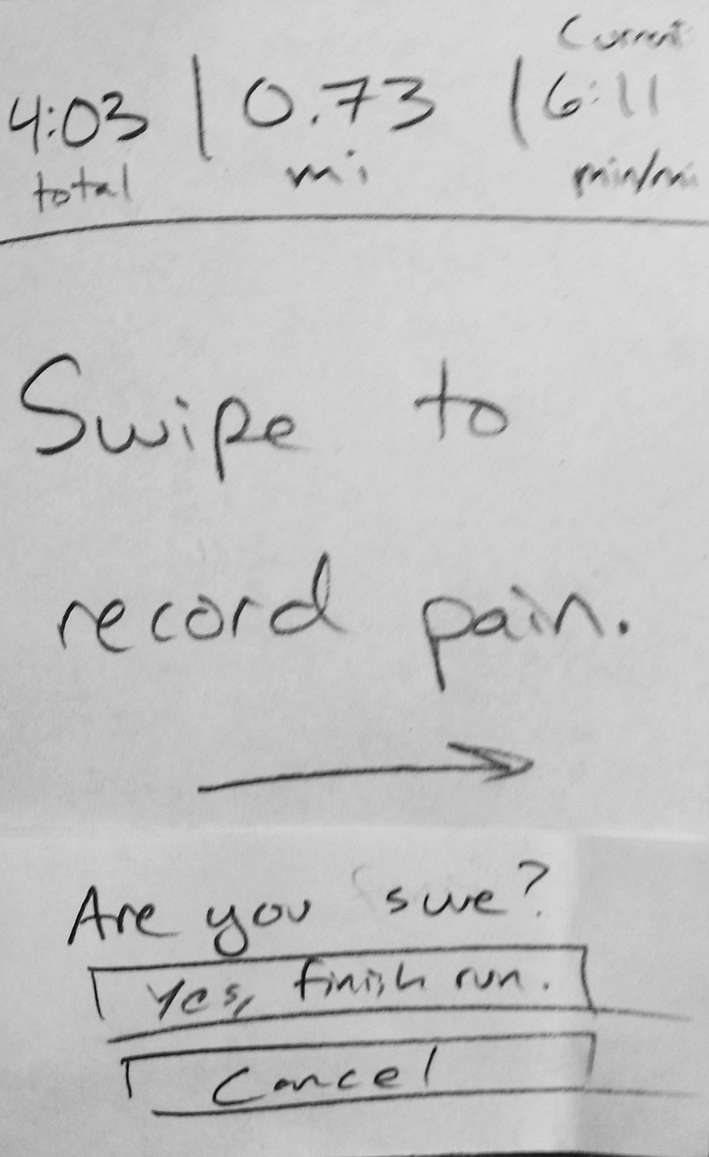
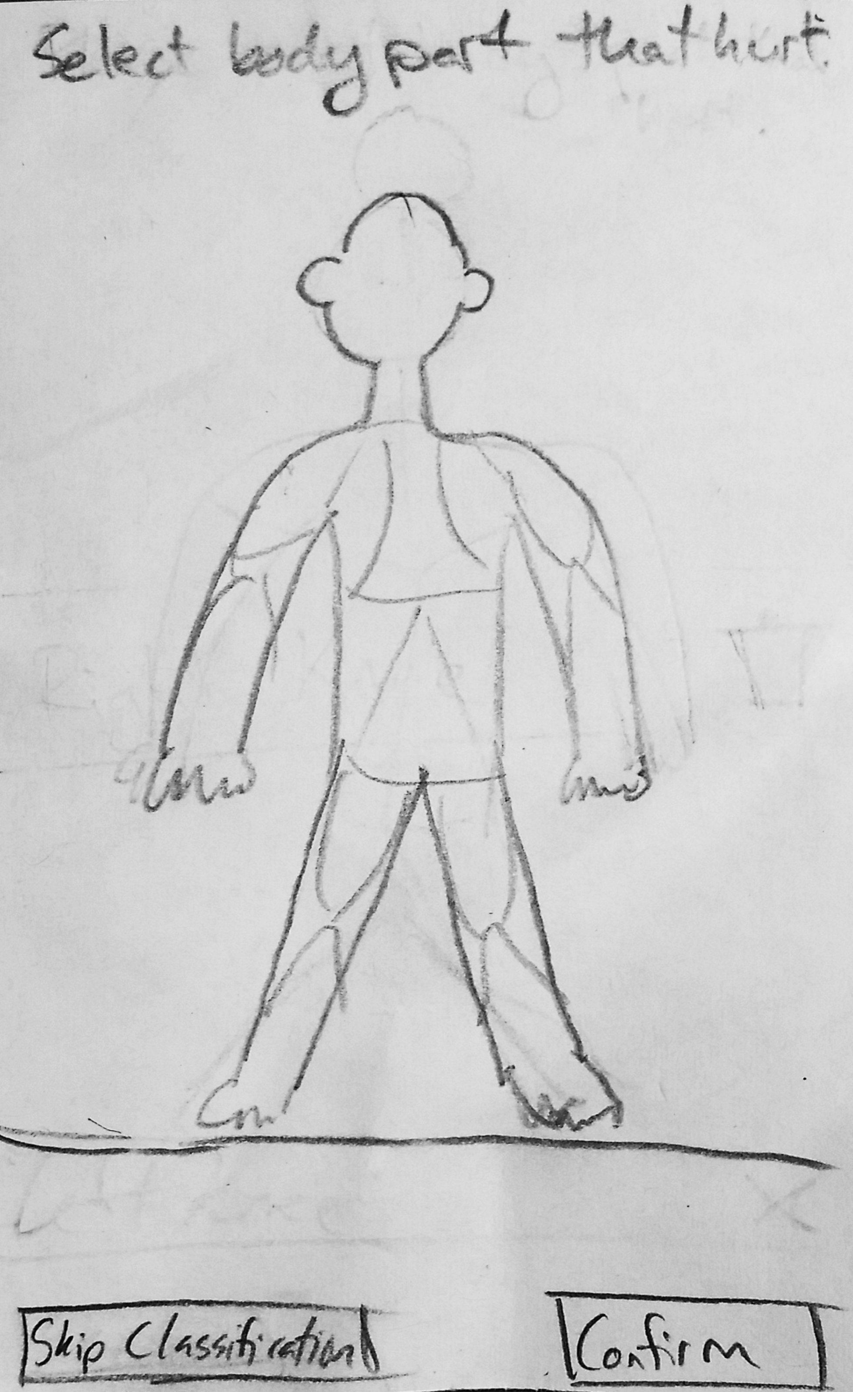
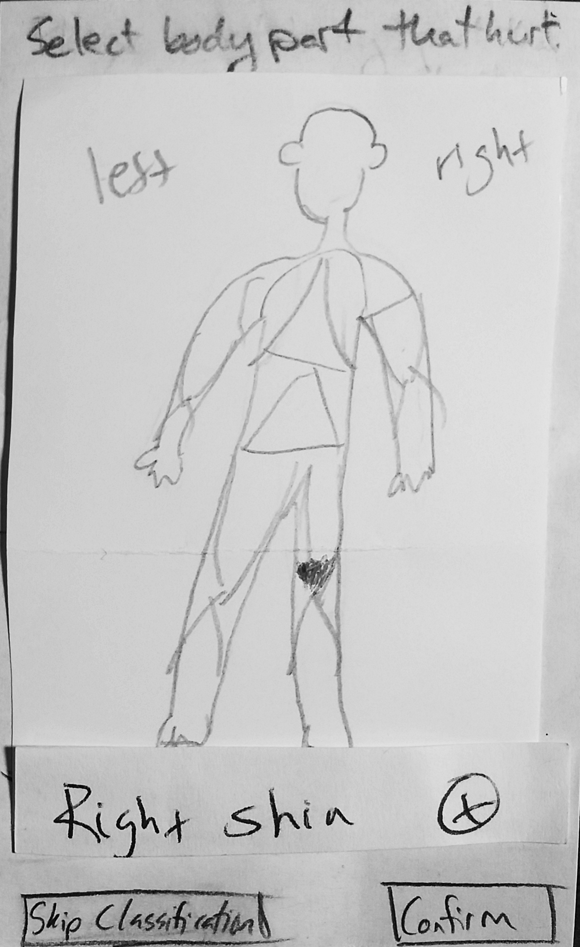
Track a workout and related pain
Task 1

Slide 15
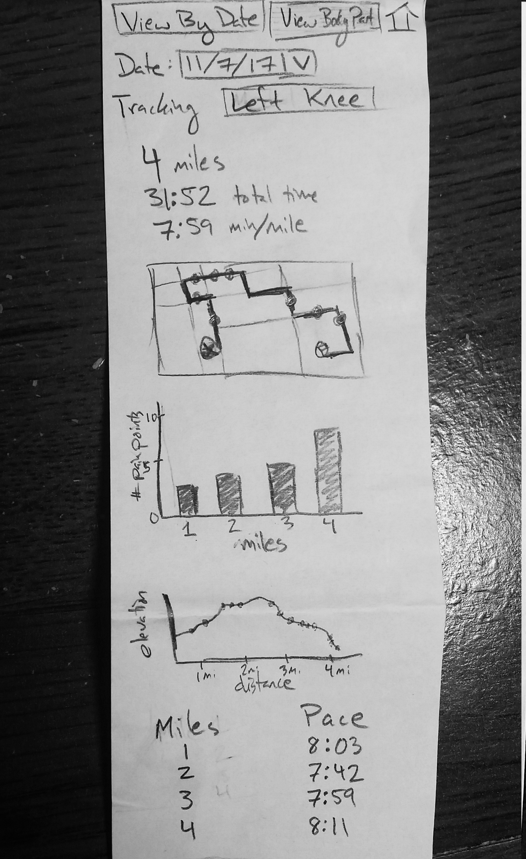
Track a workout and related pain
Task 1

Slide 16
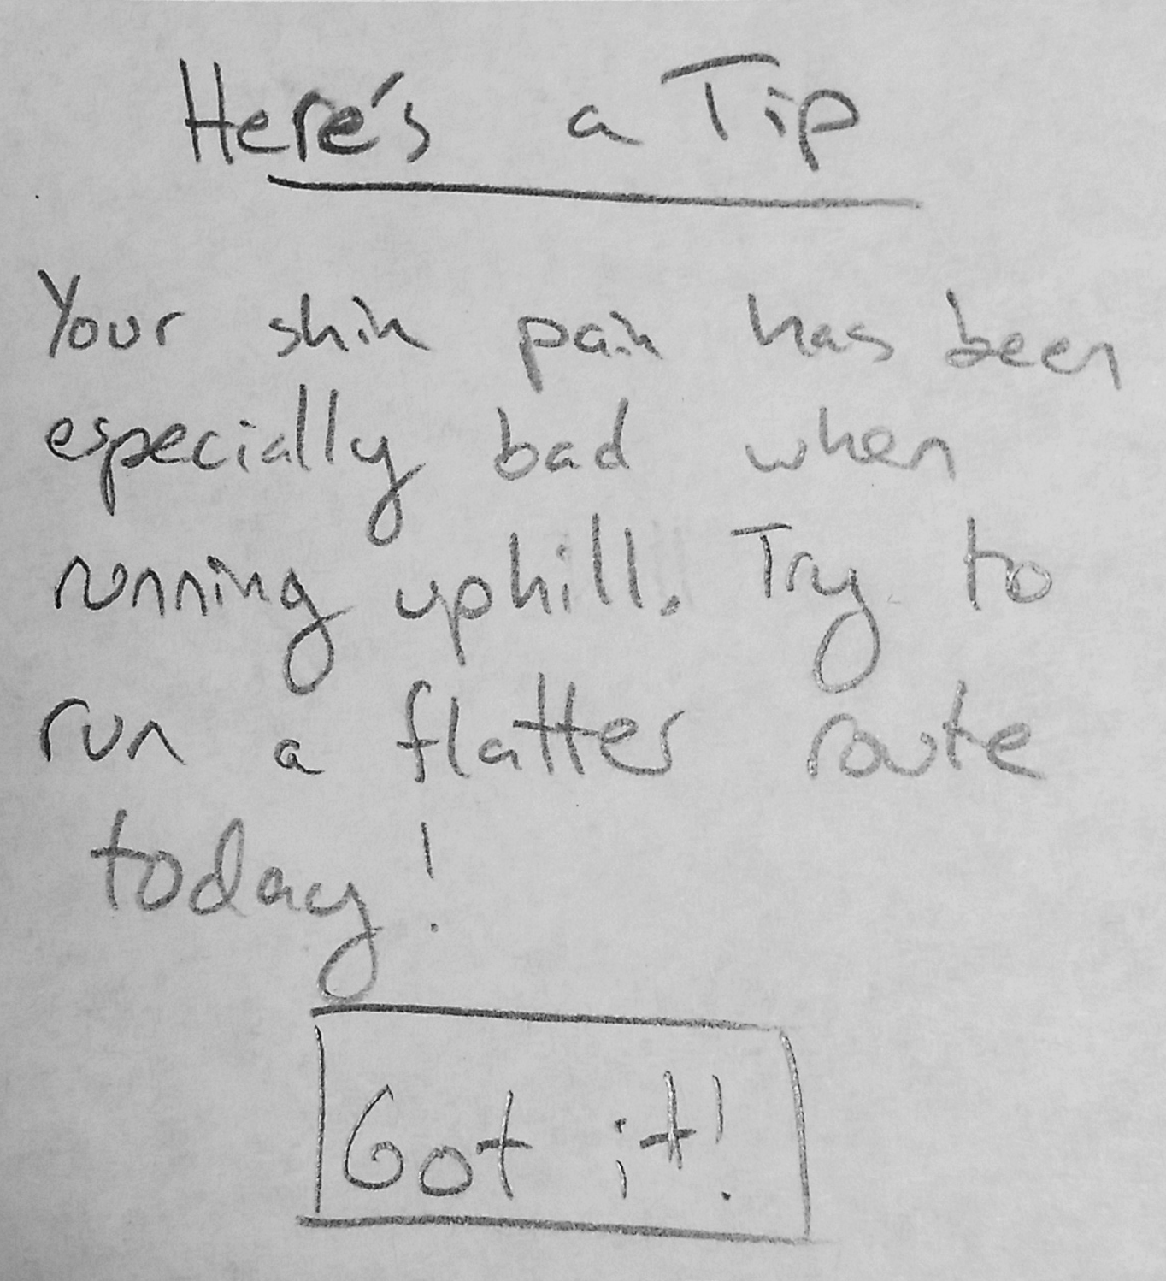
Receive injury prevention suggestions
Task 2

Slide 17
Receive injury prevention suggestions
Task 2

Slide 18
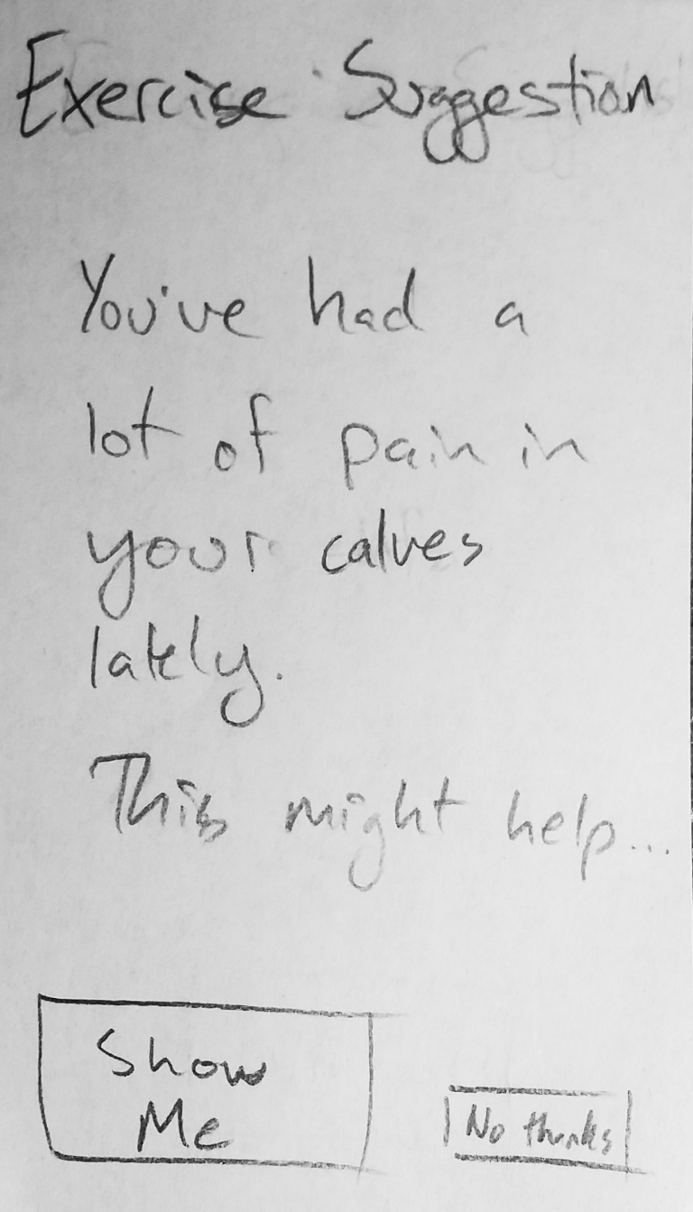
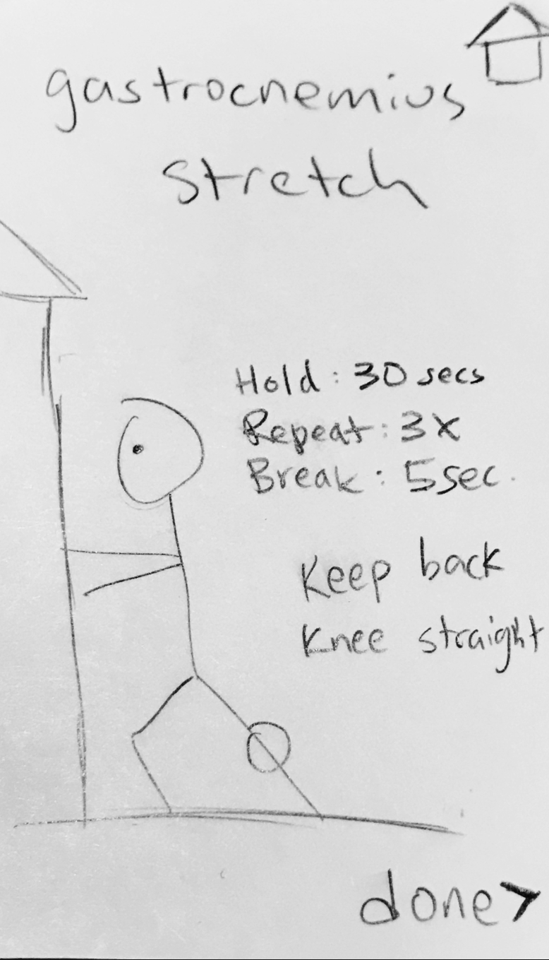
Receive injury prevention suggestions
Task 2

Slide 19

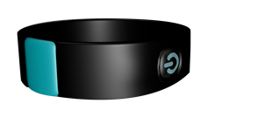
Digital Mockup

Slide 20
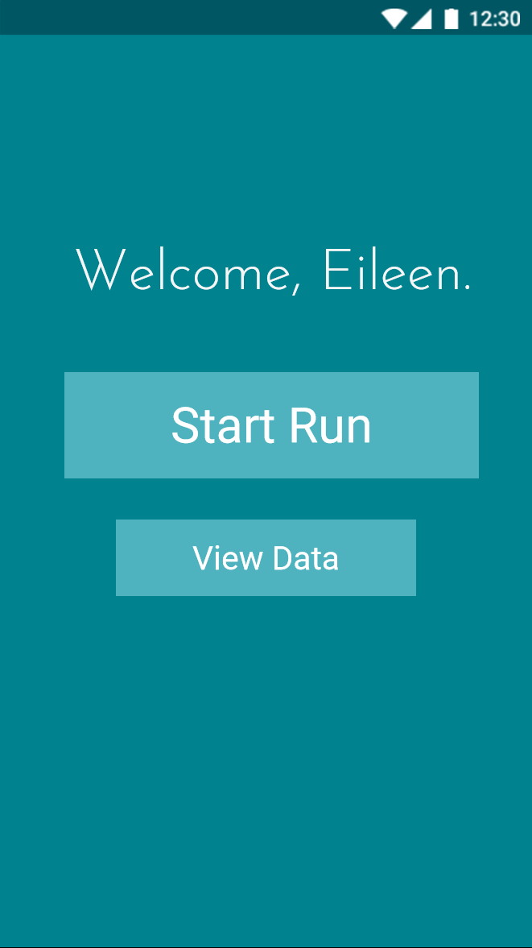
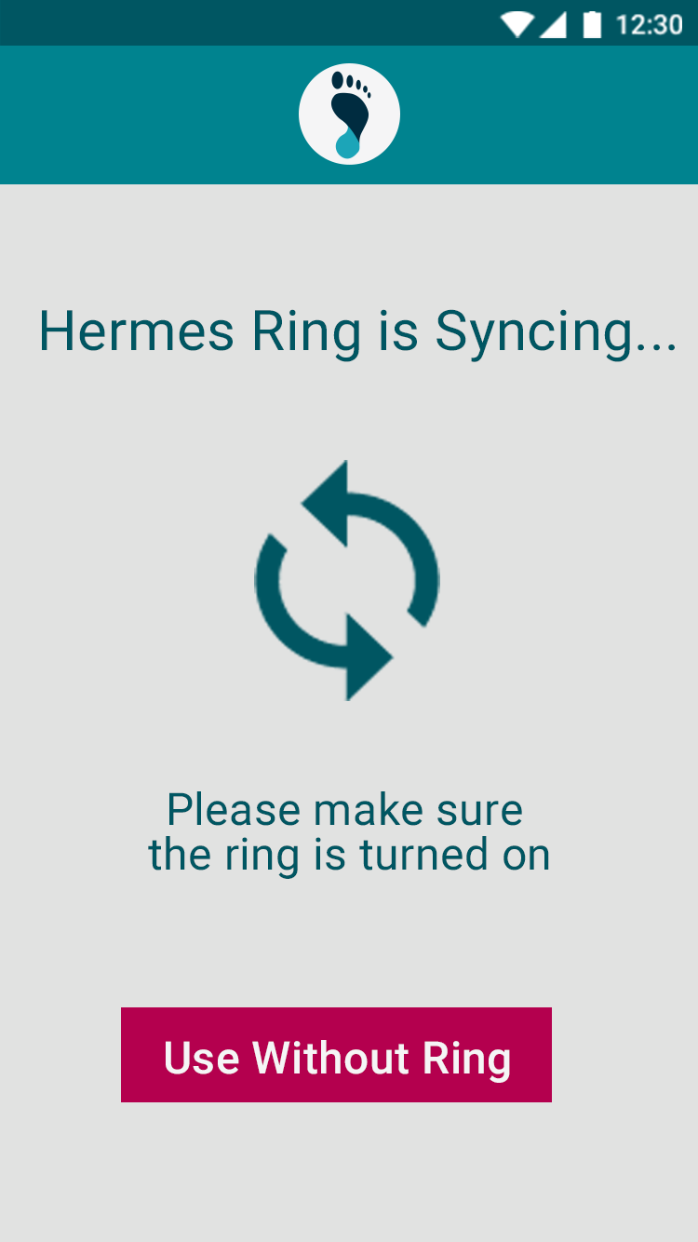
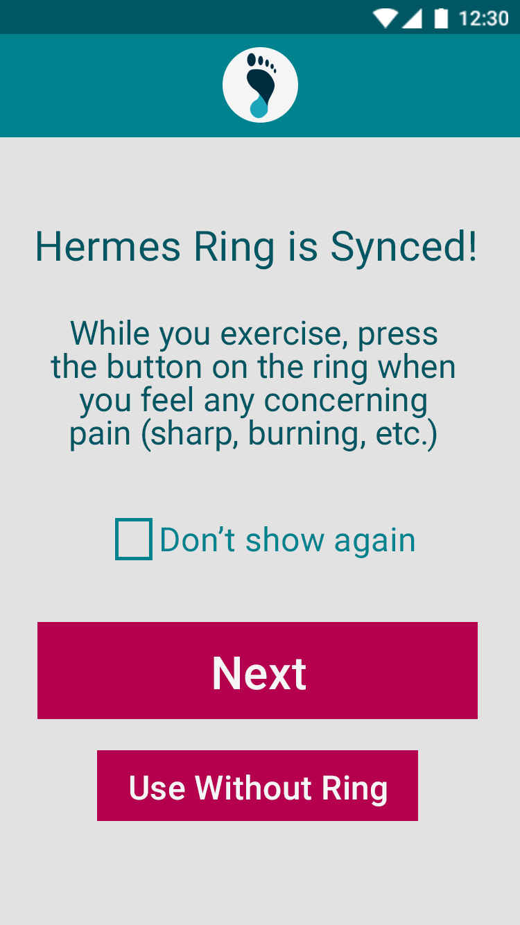
Track a workout and related pain
Task 1

Slide 21
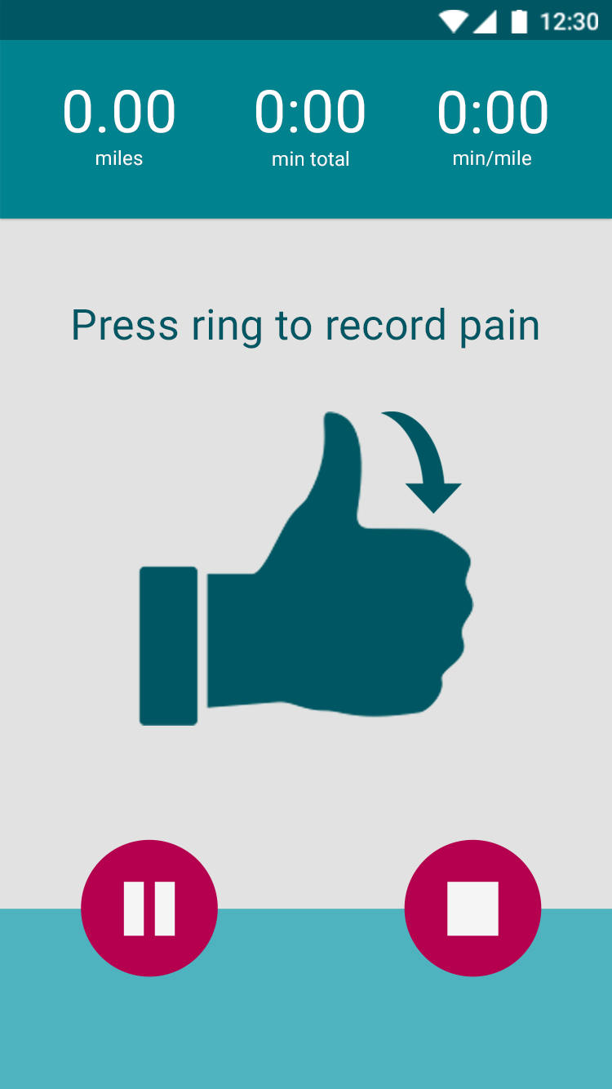

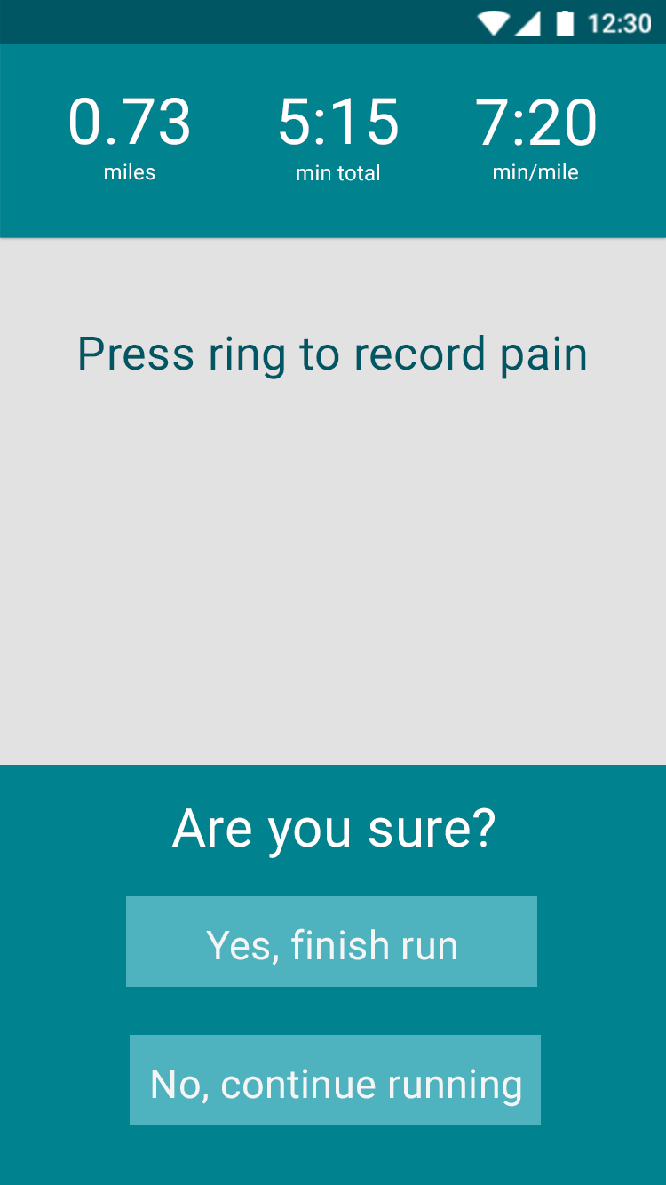
Track a workout and related pain
Task 1

Slide 22
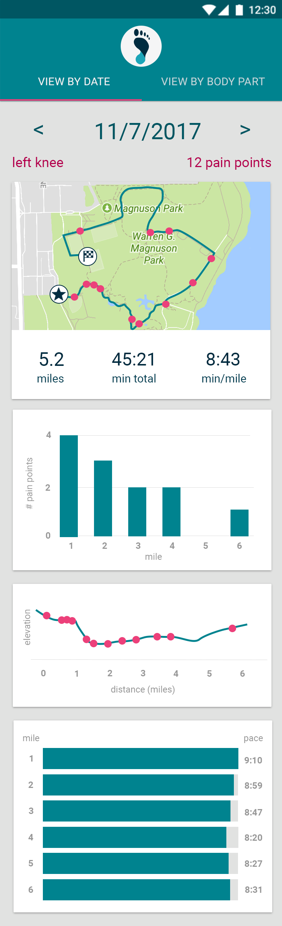
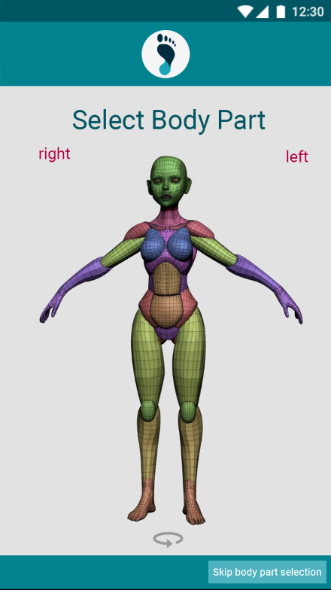
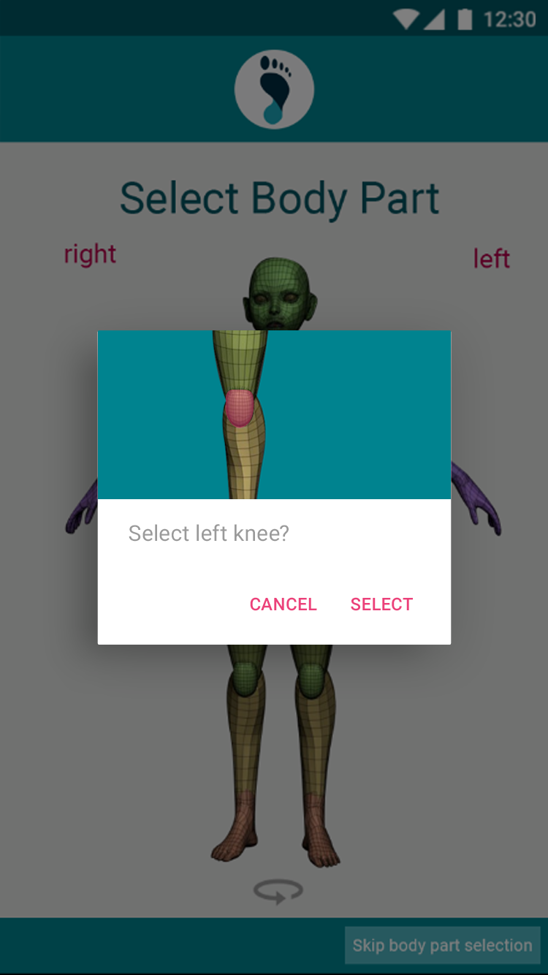
Track a workout and related pain
Task 1

Slide 23
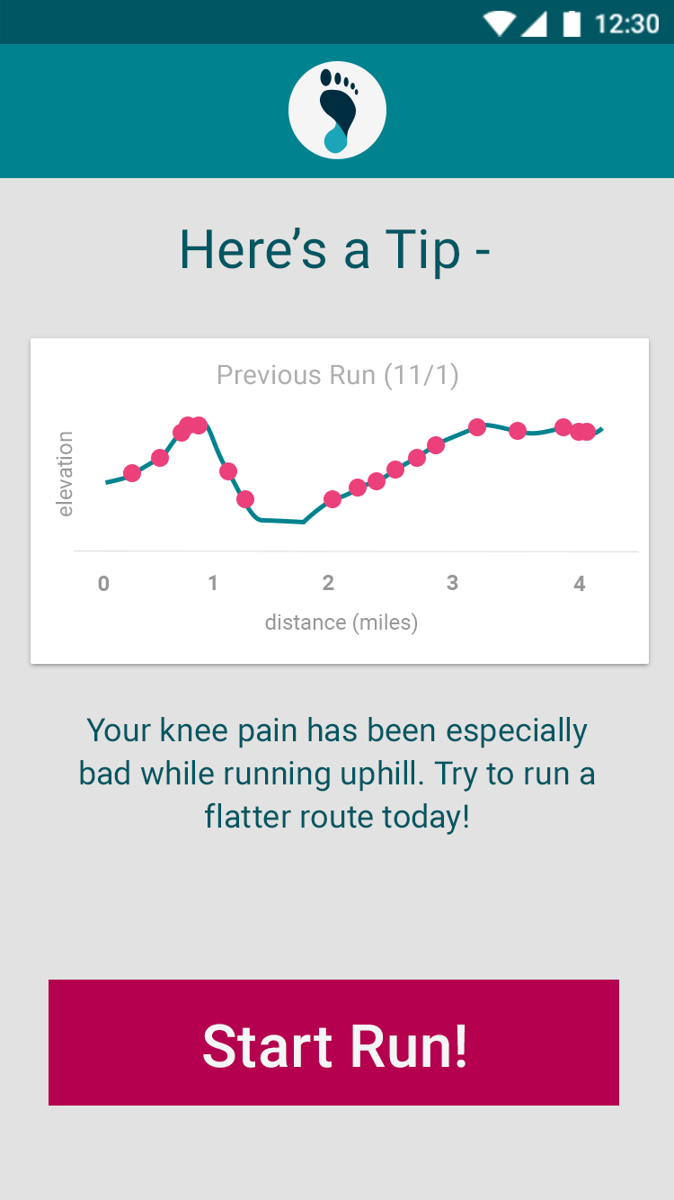
Receive injury prevention suggestions
Task 2

Slide 24
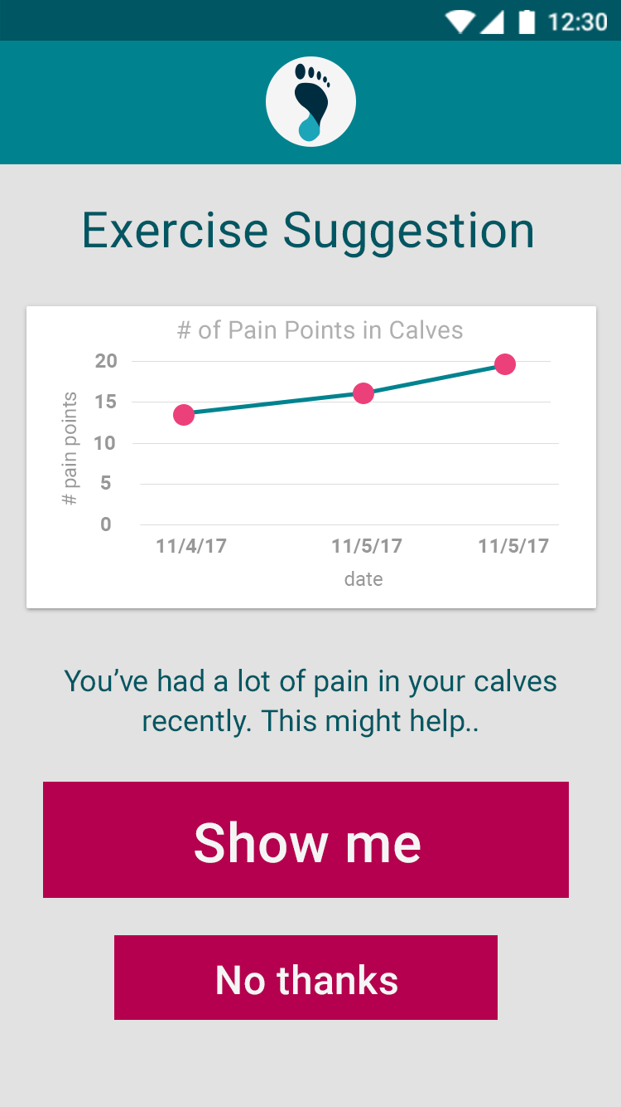
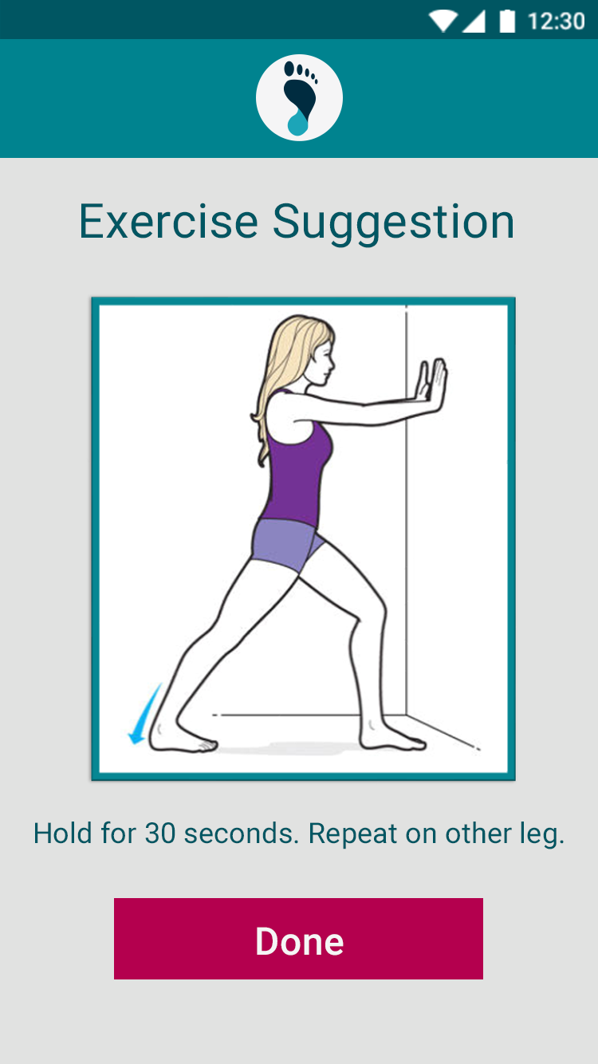
Receive injury prevention suggestions
Task 2

Slide 25

Summary
Design was initially confusing
Major changes to primary tasks
Feedback corrected issues and generated new ideas

Slide 26
Alex Vrhel Diana Wang Camille Birch Michael Wang

